Slide 1
Equity Market Rationality Amid COVID-19: Can Consumer Discretionary Stocks be Priced Predictably During a Pandemic?

Slide 2
Abstract
Introduction & Methodology
I determined the best data series to explain movements in consumer discretionary equities as COVID-19 took hold in the US
I used a linear regression approach to synthesize data and to generate predictions
Data Collection & Analysis
Information from multiple sources formed a five-fold dataset: Consumer Sentiment, Personal Consumption, COVID-19 Case Counts, Payment Card Spending Growth, and Stock Price Movements
Data cleaning and linear interpolation played an integral role in model creation
Recursive Feature Elimination determined the best explanatory factors for stock price movements
Results &
Conclusions
Consumer discretionary stock prices are best explained by payment card data, albeit to an indeterminate degree
The model’s utility could improve in upcoming months as more recent sentiment and consumption data are made available

Slide 3
Introduction
Problem-Solving Framework
Consumer discretionary stock price movements were predicted using payment card transaction data, consumer sentiment & personal consumption info and COVID-19 case data
Linear regression and coefficients of determination were used to construct a predictive model of stock price movements
Data were collected from public and private databases
Workflow Model
Stock price, consumer sentiment and consumption, payment card spending and COVID-19 case information were aggregated
A suitable metric was the difference between predicted and actual stock prices in April 2020
Modeling tools included linear regression and recursive feature elimination
Processes Used to Solve Problem
A RFE-suggested linear regression model was implemented to predict stock price movements
Linear regression models separately featuring consumer sentiment and personal consumption, payment card spending data and COVID-19 cases were used to compare coefficients of determination among the three variable groups.

Slide 4

The Problem (Context)
Retail (non-professional) investors lack tools and sophistication of investment professionals, leading to sub-optimal investment returns during COVID-19
Average 401(k) balance down -19% in through April 2020*
I used data science to offer a predictable guide to price movements in consumer discretionary stocks amidst the COVID-19 pandemic
Individual investors could have a clearer understanding of stock price movements during COVID-19, potentially reducing the inherent uncertainty of equity investment
*Source: Fidelity Investments (https://www.fool.com/investing/2020/04/28/heres-the-impact-of-covid-19-on-the-average-americ.aspx)

Slide 5

Purpose of the Study
What I hoped to achieve from analysis: make the little guy smarter
Simply put, I wanted to provide individual, non-professional investors with a predictive measure of consumer discretionary stocks as the US economy emerges from a COVID-19-induced lockdown

Slide 6





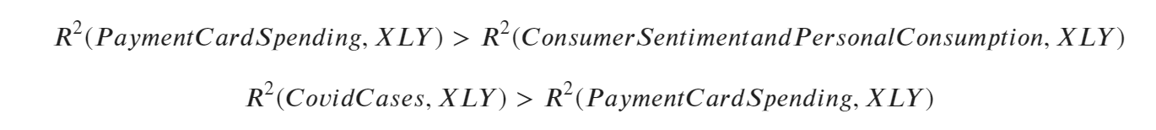
Project Description: Hypothesis
Are Consumer Discretionary Stocks Best Predicted by Sentiment and General Consumption, by Payment Card Transactions, or by COVID-19 cases?
To answer this question, I collected data from five different sources:
I hypothesized the following relationships among these data sources:

Slide 7
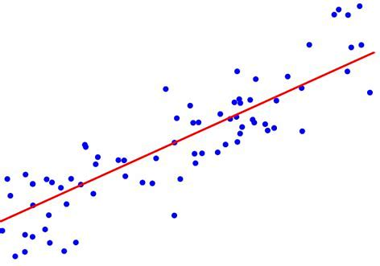
Project Description: Workflow
What data did I focus on?
What analysis did I run?
1. University of Michigan Consumer Sentiment Index
2. Personal Consumption Expenditure (excluding food & energy)
3. Year-on-year payment card spending growth
4. United States COVID-19 case counts
5. XLY (consumer discretionary stock) equity price movement
Linear Regression

Slide 8


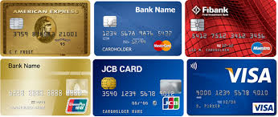

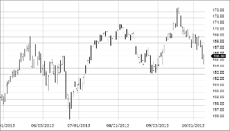
Project Description: Workflow
Consumer Sentiment Data
`
Personal Consumption Data
Payment Card Spending Data
COVID-19 Case Data
Consumer Discretionary Stock Price Data
Data Source | University of Michigan Consumer Sentiment Index | Federal Reserve Bank of St. Louis | Bloomberg | World Health Organization Database | Wall Street Journal Markets
Key Attributes | Monthly index Aggregate score of 50 questions | Monthly entry Specifies consumption of goods and of all goods & services excluding food & energy | Monthly entry Year-on-year spending growth in disparate consumer categories (e.g., clothing, restaurants) | Daily entry Daily and cumulative case counts in the United States | Daily closing prices
Cleaning | Reformat dates to datetimes Linear interpolation of monthly data to daily values | Reformat dates to date times Linear interpolation of monthly data to daily values | Transposition of dataframe Linear interpolation of monthly data to daily values | Filtering for United States cases | Reformat dates to date times

Slide 9
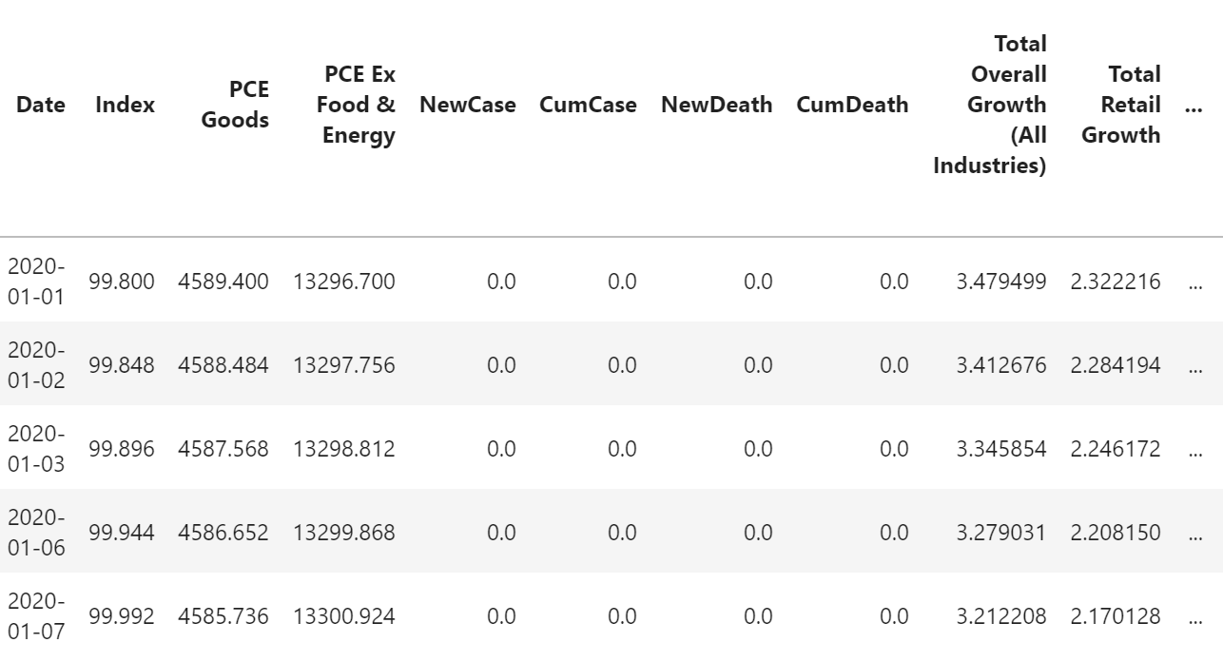
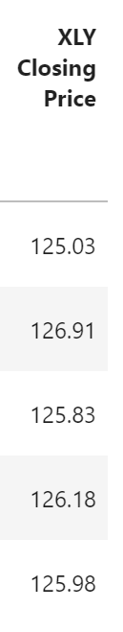
Project Description: Workflow
Data Overview
Consumer Sentiment Index Data
`
Personal Consumption Data
Payment Card Spending Data
Consumer Discretionary Stock Price Data
COVID-19 Case Data

Slide 10
Project Description: Workflow
Decide on regression model
Linear Regression
What type of learning?
Recursive Feature Elimination

Slide 11
Project Description: Workflow
Models
Prep
Split data into training and test sets (80% training, 20% test)
Done using fixed seed
Model used
Linear Regression
Machine Learning models not feasible for use given continuous data (e.g., stock prices)

Slide 12
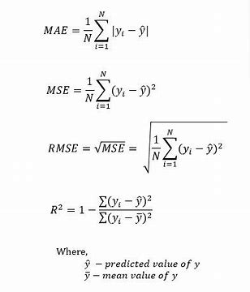
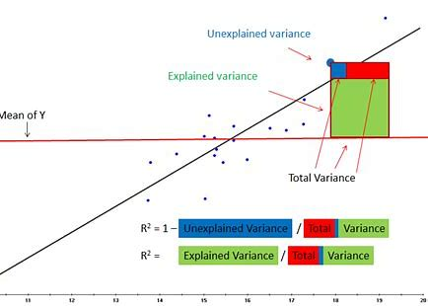
Project Description: Methods
R-squared was used in conjunction with Mean Absolute Error (MAE), Mean Squared Error (MSE), and Root Mean Squared Error (RMSE) to determine the model’s effectiveness

Slide 13
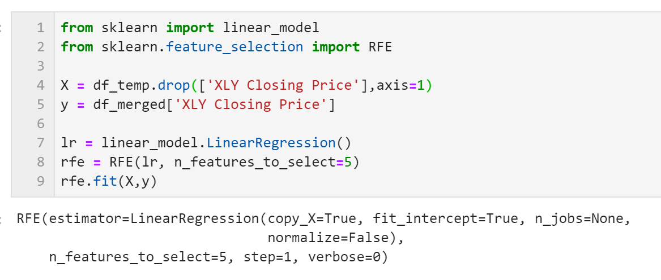
Project Description: Analysis
Using Recursive Feature Elimination (RFE)
In Python, the RFE module performs this process
I generated multiple sets of parameters, starting with 10 and ultimately narrowing to five to maximize R²

Slide 14
Project Description: Results
Independent Variables | R² | Mean Absolute Error (MAE) | Mean Squared Error (MSE) | Root Mean Squared Error (RMSE)
Consumer Sentiment, Personal Consumption | 0.83 | 5.45 | 39.43 | 6.27
Payment Card Spending | 0.90 | 3.64 | 22.13 | 4.70
COVID-19 Cases | 0.84 | 4.95 | 36.04 | 6.00
Payment Card Spending performed best across the board…
….however, COVID-19 Cases’ R² did not exceed that of Payment Card Spending
Hypotheses Affirmed
Affirmed:
Rejected:
Model validation still needed with more recent Consumer Sentiment, Personal Consumption and Payment Card Spending data

Slide 15
Conclusion
Payment card spending data better predict stock prices than do consumer sentiment and personal consumption measures provided to the general public
Model validation with more recent data awaits
Next steps: refine model with more robust spending data (e.g., credit card transactions from JPMorgan Chase), incorporate more recent economic and spending data when available
Potential Improvements
Data
Model
Detailed measures of consumer sentiment (e.g., concerning personal financial situations) More robust payment card spending data (e.g., daily transactions—eliminating the need for linear interpolation to capture intra-month changes)
Incorporating better data RFE algorithm will select more predictive features with better data, longer time series

Slide 16
Bibliography
University of Michigan Consumer Sentiment Index: https://data.sca.isr.umich.edu/
Federal Reserve Bank of St. Louis: https://research.stlouisfed.org/ssi/search.php?q=personal%20consumption%20expenditure%20monthly
COVID-19 Cases: https://data.humdata.org/dataset/novel-coronavirus-2019-ncov-cases
*Please add slides as required.

